Slide 1
Social Media Analytics
Topic 7: Online Reputation Management

Slide 2
Learning Objectives
What is Online Reputation Management?
Why is ORM great for your business?

Slide 3
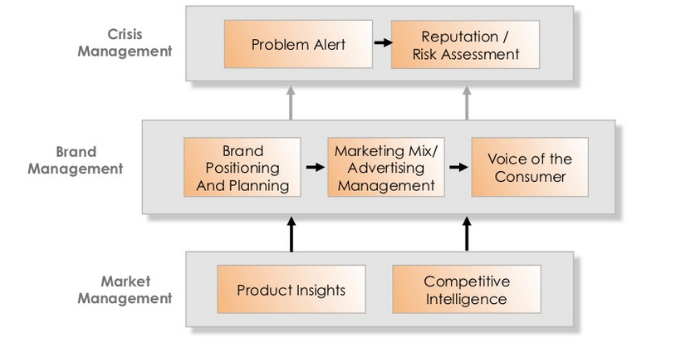
Recap – Why is social media listening important?

Slide 4

What is Online Reputation Management (ORM)?
ORM is a process of ensuring that the right information appears when people look you (or the name of your brand) up in search engine such as Google or Yahoo!, or on social networks like Facebook, Twitter or LinkedIn
Minimize negative content and promote flattering content

Slide 5
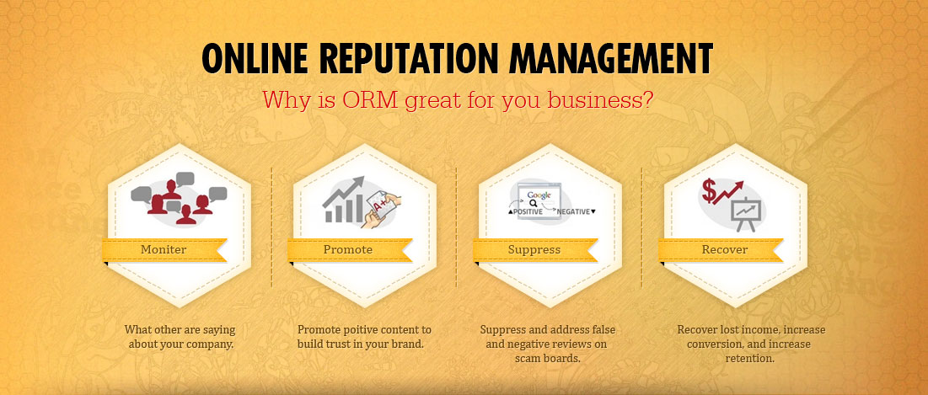
Why is ORM great for your business?
Safetyseo.com

Slide 6
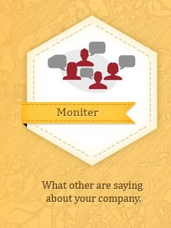
Monitor
BE PROACTIVE AND POSITIVE
Monitor search engines and social network to mitigate negative comments
Responding as quickly as possible in the event of great breaking news or a crisis
Validating the commenter’s point of view can build a lasting, durable relationship

Slide 7

Promote
Promoting positive content through discovering and inspiring brand evangelists
Nurtures the relationships and pays big dividends for your online reputation
Savvy online reputation managers identify their most influential brand promoters by looking through blogosphere, Facebook, Twitter, LinkedIn, and Google

Slide 8
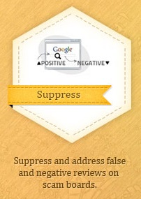
Suppress
Online meltdowns often strike out of nowhere and spread amazingly fast
Most people online like to do good or to share stories that they feel newsworthy
In real crisis, those passionate responses are directed to you and the best way to dissipate that high emotional energy is to address the issue

Slide 9
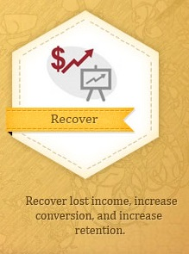
Recover
With a strategy in place, you may be able to response quickly enough to limit the damage
Trust has been earned
Reputation have been enhanced
Demonstrates how cool your brand is, both internally and to the world
Rewarding your team

